Slide 1
SMART BASKET – GROCERY(ONLINE SHOPPING)
R.SAI NARAYAN(221801042)
S.SEBRINA CATHRIENE ROSE(221801048)
P.SWETHA(221801054)

Slide 2
PROBLEM STATEMENT:
Online grocery shoppers often face challenges like spending excessive time searching for items, forgetting frequently purchased products, and dealing with a lack of personalization. Current systems do not effectively adapt to user preferences or streamline the shopping experience. Additionally, buyers have no clear way to manage spending during the shopping process, often leading to budget overruns. This project aims to develop a Smart Basket system that offers intelligent product suggestions, auto-generates shopping lists, and includes a budget constraint feature to help users shop efficiently within their financial limits.

Slide 3
ABSTRACT:
SmartBasket is an AI-driven retail solution designed to enhance in-store shopping by providing intelligent, personalized assistance. It integrates hybrid filtering for product recommendations, A* pathfinding for optimized store navigation, ARIMA/Prophet for dynamic price forecasting, and Simple Moving Average (SMA) for usage-based restocking alerts. The system analyzes individual purchasing behavior and retail data to predict needs and guide customers efficiently. It minimizes shopping time, supports cost-effective decisions, and improves user convenience. Designed with scalability and user adaptability in mind, SmartBasket redefines the modern retail experience. This project demonstrates the practical implementation of advanced AI in everyday consumer environments.

Slide 4
EXISTING SYSTEM:
Manual Shopping Experience: Most retail stores still rely on traditional shopping methods where customers manually search for products without guided navigation or smart assistance.
Static Recommendations: Current recommendation systems, if available, are typically based on basic content filtering without personalized or contextual intelligence like user behavior trends or combined algorithms.
Lack of Predictive Alerts: Present systems do not offer dynamic price alerts or restocking suggestions based on consumption patterns, leading to missed savings and inconvenient stockouts.

Slide 5
PROPOSED SYSTEM:
Personalized Product Recommendations • Uses Hybrid Filtering (Collaborative + Content-Based) for accuracy • Adapts to individual user preferences over time
Optimized In-Store Navigation • A* Pathfinding Algorithm finds shortest routes to products • Reduces customer effort and shopping time
Intelligent Purchase Reminders • Simple Moving Average (SMA) tracks product usage cycles Suggests restocking
Dynamic Price Monitoring • Time Series Forecasting (ARIMA/Prophet) predicts price trends • Sends alerts for optimal buying times to save costs

Slide 6
Author(s) | Year | Paper Title | Description
Chen et al. | 2021 | Personalized Product Recommender Using Hybrid Filtering | Introduced a hybrid filtering system combining collaborative and content-based methods to improve accuracy in product suggestion.
Rahman & Gupta | 2022 | Indoor Navigation Using A* Pathfinding in Smart Retail | Applied A* pathfinding in indoor store layouts to guide users efficiently to products, reducing shopping time.
Zhang et al. | 2022 | Time Series Forecasting for Retail Price Optimization | Used Facebook Prophet to forecast product price trends and notify customers of favorable purchase windows.
Banerjee & Nair | 2023 | Smart Restocking Alerts Using SMA in Retail Applications | Proposed usage-based prediction using SMA to recommend timely restocking of frequently bought items.
Lee & Thomas | 2023 | Context-Aware Retail Recommender System Using Hybrid AI Models | Developed a recommender that integrates user context, purchase history, and hybrid filtering for enhanced personalization.
Oliveira et al. | 2023 | Smart Shopping Carts Using Pathfinding and Purchase Prediction | Integrated A* pathfinding with purchase prediction models to optimize item collection paths and suggest additional items.
Kim & Ahuja | 2024 | AI-Driven Personalized Retail Systems with Real-Time Analytics | Demonstrated a multi-model AI system using SMA, hybrid filtering, and pathfinding to optimize both product recommendations and navigation.

Slide 7
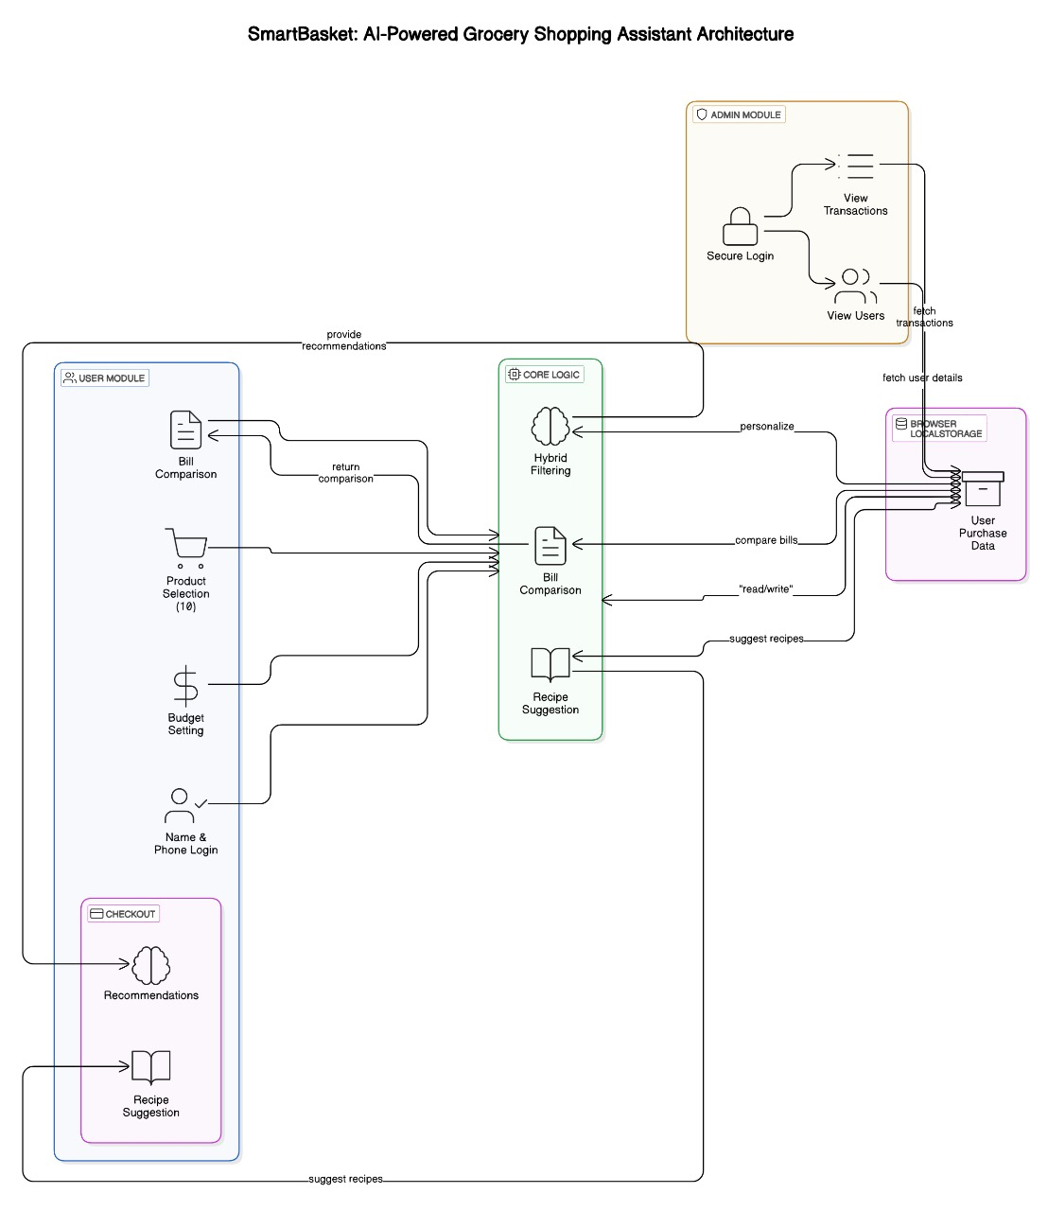
SYSTEM ARCHITECTURE:

Slide 8
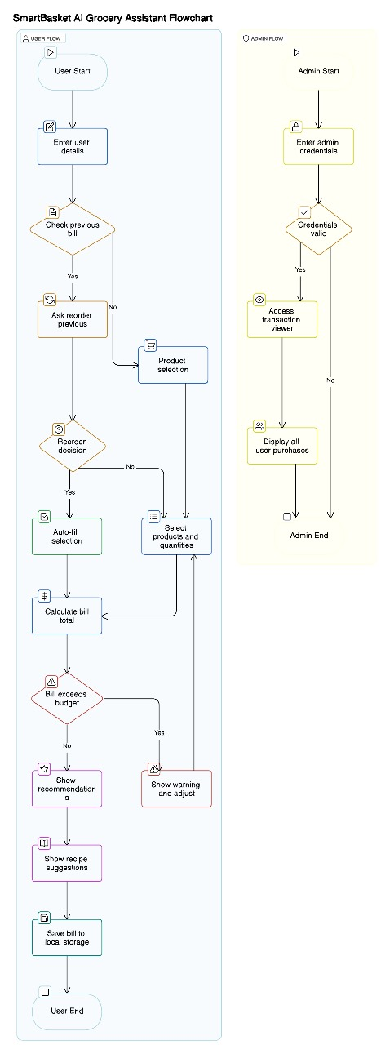
DATA FLOW DIAGRAM:

Slide 9

OUTPUT:

Slide 10
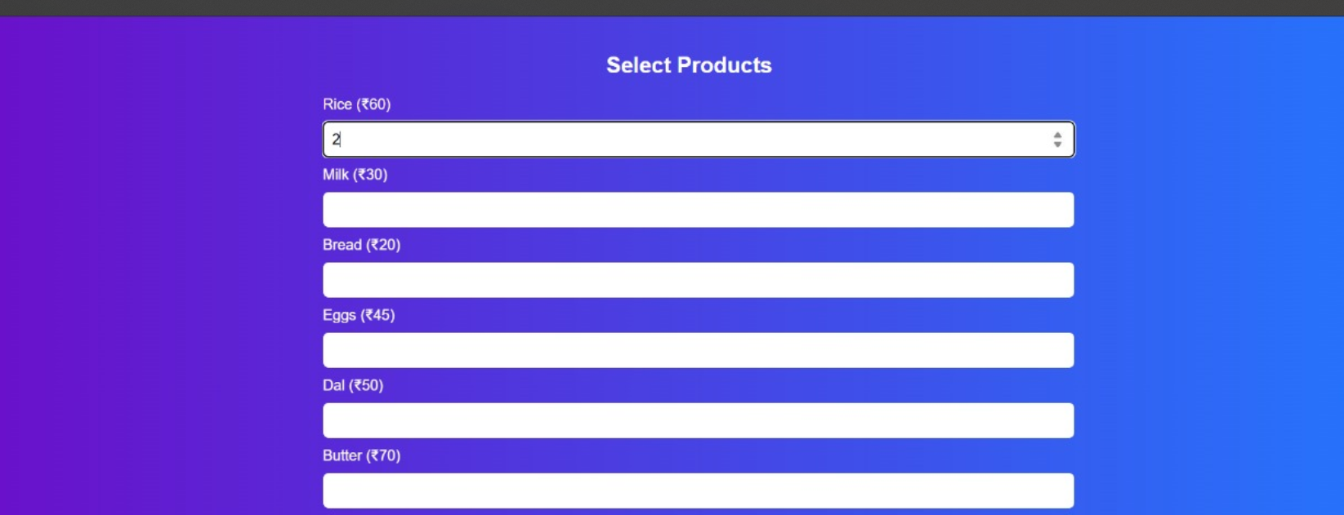

Slide 11
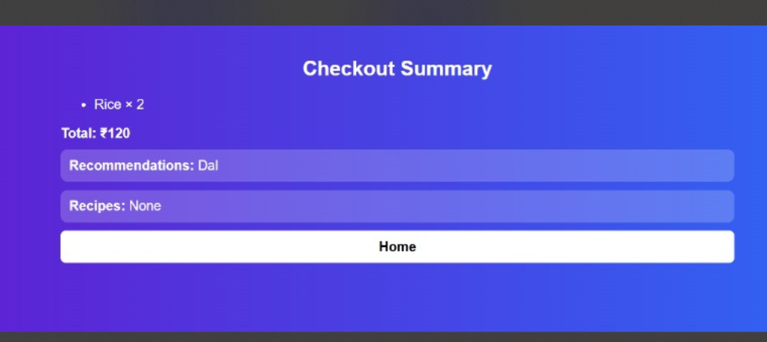

Slide 12

CONCLUSIONS:
The Smart Basket project successfully integrates AI technologies to optimize the grocery shopping experience. By utilizing Hybrid Filtering, A* Pathfinding, Time Series Forecasting, and SMA, it delivers personalized recommendations, efficient store navigation, timely price predictions, and consumption-based alerts. The system enhances user convenience while promoting smart budgeting and efficient purchasing behavior. Real-time interaction with user data ensures tailored suggestions and increased satisfaction. The modular architecture supports scalability and future updates. Overall, Smart Basket proves to be a robust, intelligent solution for modern retail needs. It sets the stage for future advancements in AI-driven retail systems.

Slide 13
REFERENCES:
Singh, K., & Bansal, R. (2022). A deep learning-based dynamic price prediction and alert system for retail. Journal of Ambient Intelligence and Humanized Computing, 13(5), 2515–2527.
Elhoseny, M., & Ramírez-González, G. (2021). Toward smart retail systems: A review on recent technologies and future trends. IEEE Access, 9, 89633–89651.
Sharma, R., & Thakur, A. (2021). Usage-based reordering system using time-series analysis in smart shopping applications. 2021 12th International Conference on Computing Communication and Networking Technologies (ICCCNT), IEEE, 1–6.
Ahmed, S., & Alam, M. (2023). AI-powered smart shopping cart: A review of consumer-centric applications and technologies. ACM Computing Surveys, 55(2), Article 34.

